Slide 1




Slide 2



Beyond the Basics:
Advanced Strategies for Leveraging Team Personalities
Speaker:
Nicole Banks of I AM Resource
AV Sponsor
Coffee Sponsor

Slide 3


Welcome & Thank You to Our Sponsors
AV Sponsor
Coffee Sponsors

Slide 4



Beyond the Basics:
ADVANCED STRATEGIES FOR LEVERAGING YOUR TEAM
NICOLE R. BANKS

Slide 5



AGENDA
01
Introduction
Explore personality and temperments’ impact on team dynamics
02
Discover Your Color
Identify personal temperment through interactive assesment
03
Communication Strategies
Learn effective communication technique for diverse
04
Practical Application
Apply knowledge through real-world scenarios
05
Experience
Questions & Answers

Slide 6





INTRODUCTION TO TEMPERAMENTS
Enhanced Team Dynamics
1
Diverse perspectives foster creativity, innovation, and a more inclusive environment.
2
Effective Communication
Adjusting communication styles for each temperment minimizes misunderstandings and strengthens connections.
3
Conflict Resolution
Navigate disagreements by recognizing individual communication styles.
Notes:
3

Slide 7

OVERVIEW OF TEMPERAMENTS
Red: Action-Oriented
Blue: Analytical
Yellow: Enthusiastic
Green: Calm
Detail-focused professionals who value accuracy and reflection.
Steady team members who promote harmony and stability.
Bold and driven individuals who thrive on challenges and taking charge
Social butterflies who bring energy and positivity to the team.
Content on Pages 3-4
Notes:
4

Slide 8




KEY TEMPERAMENT CHARACTERISTICS
Goal-focused, direct, natural leaders
Needs: Achievement and control.
Prefers direct and assertive communication
Red
Analytical, planners, detail-oriented
Needs: Structure and accuracy.
Appreciates detailed and logical explanations.
Blue
Creative, social, adaptable
Needs: Social interaction and appreciation.
Thrives in energetic and enthusiastic conversations.
Yellow
Green
Supportive, stable, conflict-avoidant
Needs: Harmony and security.
Responds well to calm and patient dialogue.
Content on Pages 3-4
Notes:
5

Slide 9

DISCOVER YOUR COLOR
1
Self-Reflection
2
Sample Statements
3
Group Discussion
Consider your natural reactions in various situations to identify your dominant temperament.
Please take your Self-assessment on page 5.
Respond to the statements on the handout to gauge how you can feel fulfilled, energized, and balanced in your personal and professional life.
Share insights and observations with team members to better understand how your temperament impacts dynamics
Content on Pages 5-6
Notes:
6

Slide 10









FILLING YOUR BUCKET
Content on Page 7 of your handout provides a complete list of fulfillment strategies for each temperment.
Red: Goal Setting
Blue: Analysis
Yellow: Creativity
Green: Stability
Take on leadership roles and challenging projects.
Engage in deep research and problem-solving tasks.
Plan social events and brainstorming sessions.
Create a calm environment and consistent routines.
Content on Page 7
Notes:
7

Slide 11


FILL SOMEONE ELSE'S BUCKET
Provide direct feedback and recognize achievements promptly.
Communicate with clarity and provide detailed explanations.
Use positive reinforcement and encourage creative brainstorming.
Maintain harmony and communicate with empathy.
Content on Page 8
Notes:
8

Slide 12



ENCOURAGING COMMUNICATION
Encourage Open Dialogue: Create a safe space for team members to express their thoughts and emotions. This encourages transparency and trust within the team.
Practice Empathy: Acknowledge that each person’s temperament influences how they perceive and respond to situations. Tailor your responses to show understanding and compassion.
Leverage Strengths: Highlight each temperament’s unique strengths and assign tasks that align with these strengths. This leads to better engagement and higher team morale.
Content on Pages 9-11
Notes:
9

Slide 13




PRACTICAL APPLICATION
Conflict Resolution
Project Planning
Team Communication
Navigate disagreements by understanding the underlying temperament-driven perspectives. Use empathy and patience to guide discussions toward resolution.
Assign roles based on temperament strengths. For example, a Red temperament can lead goal setting, while a Blue temperament manages detailed planning.
Adapt your leadership style and communication methods to motivate each temperament. Utilize assertive communication for Red and empathetic dialogue for Green.
Notes:
10

Slide 14
PRACTICAL APPLICATION
Scenario Examples:
Conflict Resolution
If a Red team member’s directness clashes with a Green member’s preference for harmony, use phrases like: ‘I appreciate your patience, and I want to make sure we address all concerns.
Project Planning:
Assign tasks based on each temperament’s strengths. For a Blue temperament, say: ‘Your detailed approach will ensure we don’t miss anything important.
For more examples and detailed phrases, refer to Page 11 in your handout and take a moment craft your encouragement message.
Notes:
10

Slide 15

ENCOURAGEMENT
CALL OUT

Slide 16

IMPACT OF UNDERSTANDING TEMPERAMENTS ON
TEAM RESULTS
Productivity Boost
21% increase in team output.
Enhanced Performance
35% improvement for diverse teams.
Conflict Reduction
20-30% fewer interpersonal issues.
Employee Retention
25% lower turnover rate.
Notes:
9

Slide 17
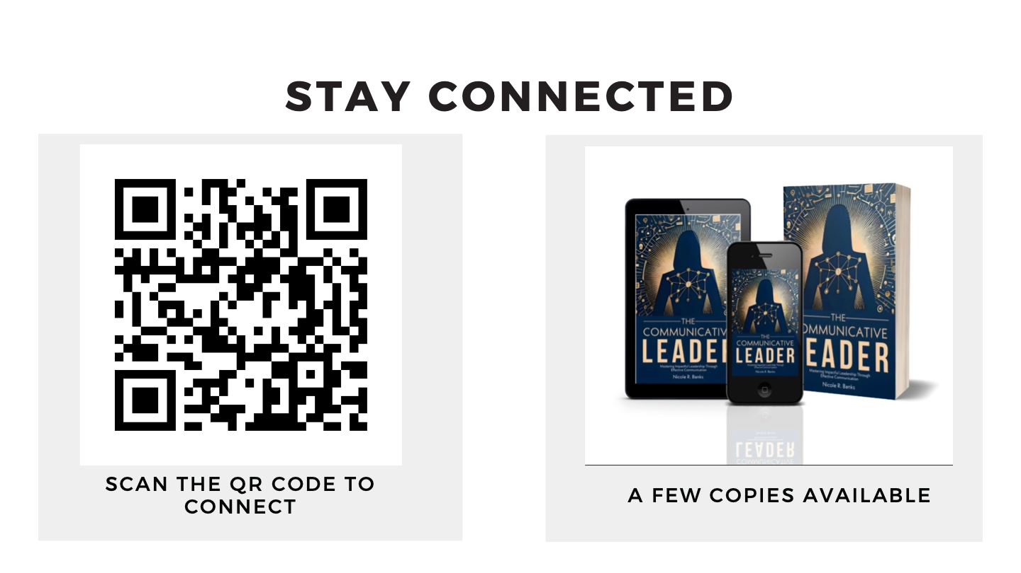

Slide 18
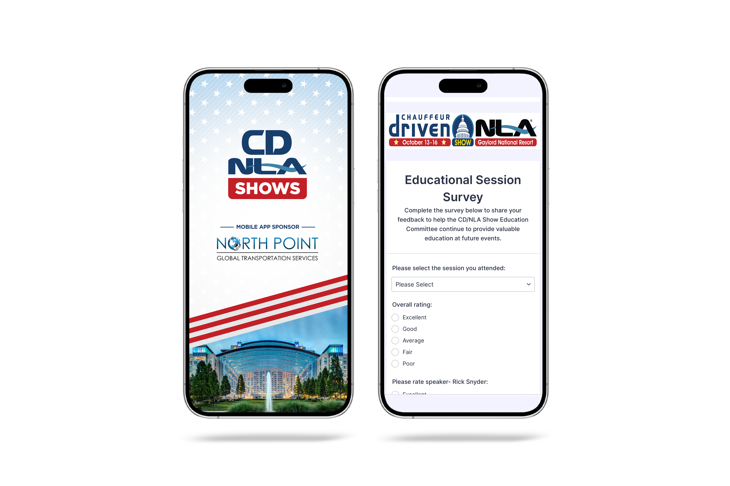
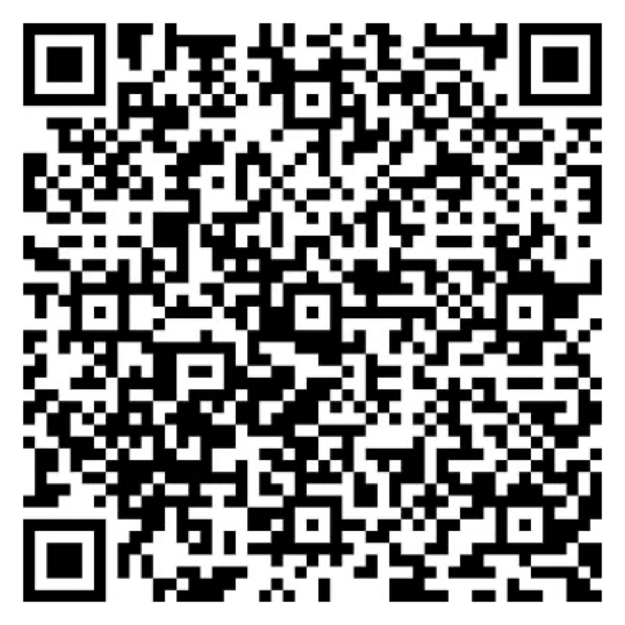

Let Us Know How
We Did!
Fill Out the Survey
AV Sponsor
Coffee Sponsor

Slide 19
Thank You for Joining Us!
AV Sponsor
Coffee Sponsor

